Slide 1
COS 711 Guest Lecture
Self-Organising Feature Maps

Slide 2
Overview
The SOM: An Overview
Architecture
Stochastic Training
Batch Map
Growing SOM
Improving Convergence Speed
Map Clustering
Map Visualization
Applications

Slide 3
The SOM: An Overview
Invented by Teuvo Kohonen of the Helsinki University of Technology in 1982
Inspired by the human cerebral cortex
  Motor cortex
  Somatosensory cortex
  Visual cortex
  Auditory cortex
Cortices are topologically ordered maps
  Form to represent structures sensed in input signals

Slide 4
The SOM: An Overview
Unsupervised learning Neural Network
  No explicit target output provided to the network
  Instead, finds groupings of items that are intrinsically “similar” to each other
  In a general sense, models a data set
Capable of generalisation to cases not presented during training

Slide 5

Architecture
Two-layer architecture:
  Layer 1:
    Input vector (I-dimensional)
  Layer 2:
    Two-dimensional ( ) grid of neurons (also know as the map grid)
  Weight vectors
    I-dimensional
    Connect input vector to map grid
    One associated with each neuron

Slide 6




Architecture
Definitions:
  Training set ( dimensional):
  Input vector (I dimensional):
  Weight vector (I dimensional):

Slide 7

Architecture

Slide 8
Training: Overall Objective
Operation:
  Multidimensional scaling of an I-dimensional input space to an output space of lower dimension (usually 2-dimensional)
  Loosely speaking: A approximate compression of input data
Characteristics of the mapping:
  Models probability density function of data
    Neuron’s cluster around dense, “similar” areas in the data
  Maintains local topological order of data
    If 2 patterns are close to one another in I-space, they will be close to one another in SOM output space
Notes:
Compression: Elastic net stretched over a “cloud” of data
Maintains local topological order: Unique

Slide 9

Stochastic Training
Euclidean distance
  Between arbitrary vectors V and W

Slide 10
Stochastic Training
The algorithm in a nutshell:
  Iteratively present training examples
  t represents the current training iteration
  A pass through the entire data set is called an epoch
  All weight vectors are updated based on each training example
  Weight updates are relative to a Best Matching Unit (BMU)

Slide 11

Stochastic Training
In pseudocode:

Slide 12
Stochastic Training
Map initialisation
  Weight vectors must be given initial values
  Assign random weight values
    Values bounded by the range of the corresponding input parameter
    Simple to implement
    Introduces large variance components
    Leads to increased training time

Slide 13
Stochastic Training
Map initialisation
  For each weight vector
    Select a random input pattern
    Initialise the weights using corresponding input parameter values
  Often leads to premature convergence
    Perturb weights with small random values

Slide 14
Stochastic Training
Map initialisation
  Find the 1st two principal eigenvectors of
    The two mutually orthogonal vectors that account for the most variability in the data
  Initialise weight vectors
    In an orderly fashion along a 2D subspace
    The subspace is spanned by the eigenvectors

Slide 15
Stochastic Training
Map initialisation
  Hypercube initialisation
    Weight vectors defined to form a hypercube covering all the training patterns
      Find two patterns with largest inter-pattern Euclidean distance
      Find third pattern furthest from the first two
      Find fourth pattern furthest from the first three
      These four patterns become the weight vectors of the four corner neurons of the map
      The remaining weight values are interpolated from the corner weight values

Slide 16
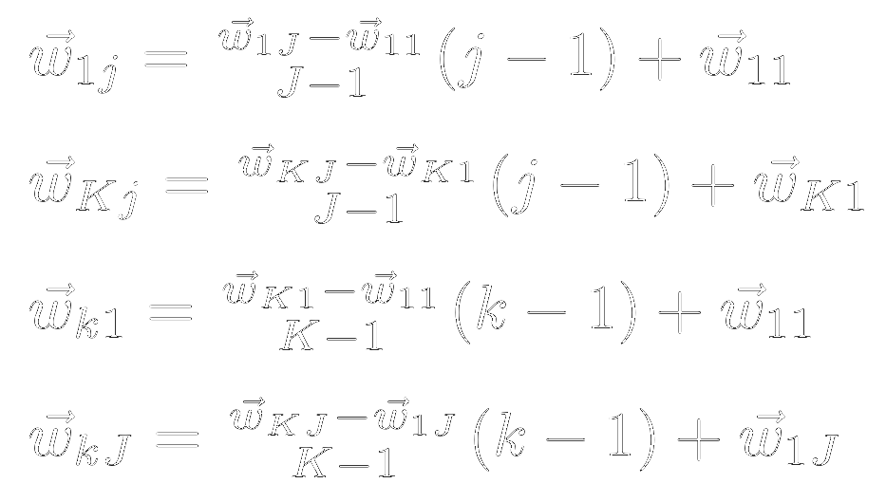
Stochastic Training
Map initialisation
  Hypercube initialisation
    Initialise weights of boundary neurons:

Slide 17

Stochastic Training
Map initialisation
  Hypercube initialisation
    Initialise remaining weights:

Slide 18

Stochastic Training
Find the BMU
  Weight vector mn
  The one closest to the current training pattern

Slide 19


Stochastic Training
Update weight vector:
Moves the weight vector of the current BMU, as well as its neighbours, closer to the current training pattern

Slide 20
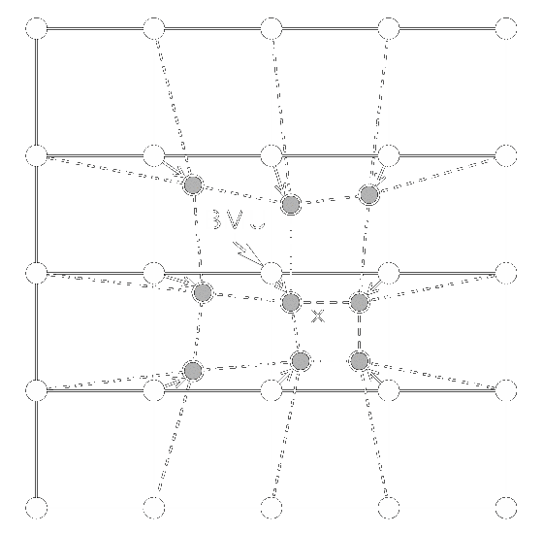
Stochastic Training
Adapted from: Olli Simula, Petri Vasara, Juha Vesanto, and Riina-Riitta Helminen. The Self-Organizing Map in industry analysis. In Industrial Applications of Neural Networks, chapter 4, pages 87–112. CRC Press, 1999.

Slide 21




Stochastic Training
Neighbourhood function
  Smooth Gaussian kernel:
Components:
  = distance between map co-ordinates
  of BMU mn and weight vector kj
  = learning rate
  (determines kernel height)
  = neighbourhood radius
  (determines kernel width)

Slide 22

Stochastic Training
A Gaussian kernel

Slide 23



Stochastic Training
Standard Gaussian
kernel
Kernel with reduced
learning rate
Kernel with reduced
neighbourhood radius

Slide 24


Stochastic Training
Both learning rate and neighbourhood radius should be
  Monotonically decreasing functions of t
  i.e. they decrease as training progresses
  For example:
Notes:
Larger tau1 and tau2 result in slower decays

Slide 25

Stochastic Training

Slide 26
Stochastic Training
Stopping conditions
  At least one must be tested every iteration
  Limit on training iterations (t)

Slide 27

Stochastic Training
Stopping conditions:
  Training error (quantisation error):
    User-selected minimal level
    Test for convergence in error:
      Fluctuations necessitate using a window
      Decrease since previous iteration (moving average)
      Standard deviation

Slide 28

Stochastic Training

Slide 29

Stochastic Training

Slide 30

Stochastic Training
Stopping conditions:
  Average component weight change
    Decreases to a minimal level close to 0

Slide 31
Batch Map
Initialise weight vectors by assigning the first K×J training patterns to them
while stopping conditions are not met do
for each neuron, kj do
Collect a list of all patterns whose BMU is neuron kj
end for
for each weight vector do
Set the weight vector to the mean over the list of patterns for the
weight vector’s neuron
end for
end while

Slide 32
Growing SOM
To find an optimal SOM architecture
  Start training with a small map
  Grow map as more neurons are required
  A growing condition is tested each iteration
    If growing is triggered
      Find the neuron, kj, with the largest quantisation error
      Find neighbour in row dimension furthest from kj
      Insert a row between the two
      Find neighbour in column dimension furthest from kj
      Insert a column between the two

Slide 33
Shortcut Winner Search
Reduce computational cost of BMU search
  Assume that a pattern’s BMU is in the vicinity of the pattern’s BMU for the previous epoch
    Calculate the distance between the pattern and the previous BMU
    Calculate the distance between the pattern and the neighbours of the previous BMU
    If the previous BMU is still the best match, use it
    Else, use neighbour that is the closest to the pattern

Slide 34
Map Clustering
Non-emergent Feature Maps:
  Each neuron represents a single cluster of training patterns
  Similar to k-means clustering
Emergent Feature Maps:
  Clusters of neurons form
  Different (emergent) behaviour to standard clustering approaches (or a non-emergent feature map)

Slide 35
Map Clustering
Emergent feature maps offer advantages, but the clusters of weight vectors still need to be discovered
Use a standard clustering algorithm on the map’s weight vectors:
  Hierarchical clustering algorithm:
    e.g. Ward clustering
  Partitional clustering algorithm:
    e.g. k-means clustering

Slide 36
Map Visualisation
Recall that:
  A SOM produces a map that approximates the distribution of its training data
  The map is defined by its weight vectors
This means that:
  A representation of the map is equivalent to an approximate representation of the data
  Most visualisation techniques are displays of the weight vectors

Slide 37
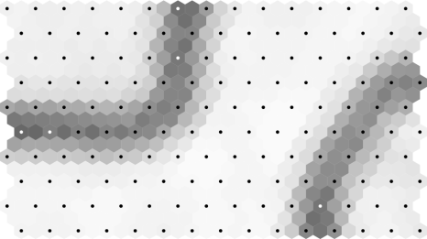
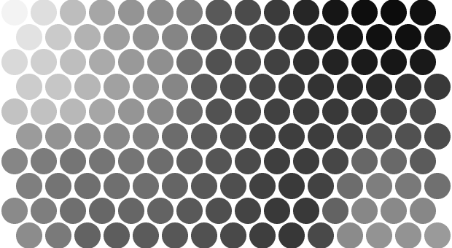
Map Visualisation
There are many map visualisation techniques
  The most commonly used
    U-matrix
      Visualises distances between weight vectors
      Shows us the cluster structures of a map
    Component planes
      Visualise one weight across the map
      Shows us the nature of the data distribution

